Slide 1
Germany: Update on recent policy developments relating to informal care(ers)
Eurocarers Policy Working Group
Vienna, 10 April 2025
Sebastian Fischer

Slide 2
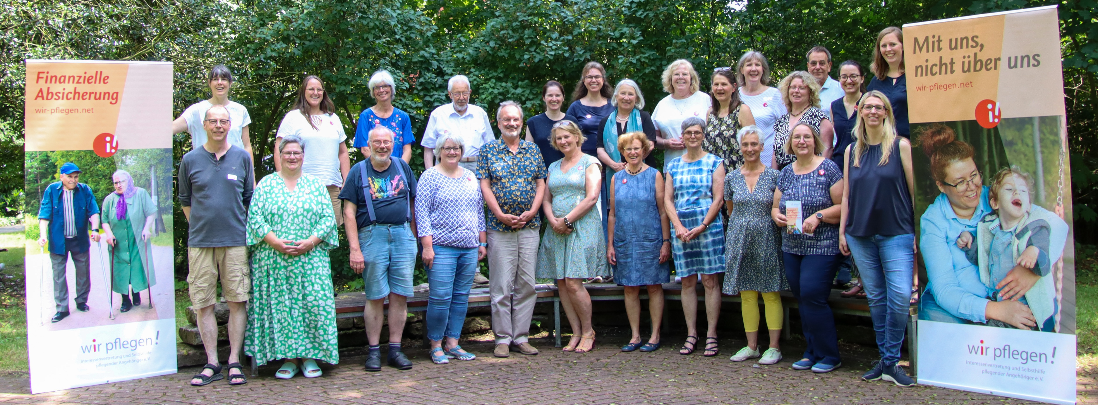
Voice of Carers

Slide 3
Pflegenotstand - Care Emergency
Growing care demand (demographic change)
Lack of professional care staff
Care entitlements can‘t be realised
Services often do not exist, or cannot provide care required
Care services are largely unaffordable (ind. contributions)
inadequate re-financing of services provided by care providers
Massive bureaucracy – little flexibility
Pflege Triage: no obligation in German law that people with high care needs need to be provided for

Slide 4
wir pflegen Advocacy (Interessenvertretung)

Slide 5
Coalition Negotiations 2025
AG 6 Gesundheit und Pflege – Seite 3
“The provision of care is a challenge for a whole generation. For this, we require a paradigm shift towards greater trust and less bureaucracy. We will quickly work up substantial care reform measures which will make the system simpler, more flexible and affordable. We will limit individual financial contributions to care, strengthen informal carers, combine care entitlements for acute situations and strengthen cross-sectoral care provision
„Die Herausforderungen in der Pflege zu bewältigen ist eine Generationenaufgabe. Dazu braucht es einen Paradigmenwechsel hin zu mehr Vertrauen und weniger Bürokratie. Wir erarbeiten zügig eine große Pflegereform, die das System einfacher, flexibler und bezahlbarer macht. Wir begrenzen pflegebedingte Eigenanteile, stärken pflegende Angehörige, bündeln bestehende Leistungen, bauen Versorgungsangebote für pflegerische Akutsituationen auf und stärken die sektorenübergreifende pflegerische Versorgung.“

Slide 6
Koalitionsverhandlungen 2025
AG 7 Familie, Frauen, Jugend, Senioren und Demokratie - Seite 5
“We aim to combine entitlements of the ‘Pflegezeitgesetz’ and the ‘Familienzeitgesetz’, make care leave more flexible and accessible to more family members. We are exploring the introduction of a right to Familienpflegegeld.”
PflegeZG = only in businesses with 15+ employees; max 6 months care leave at 90% of net salary, paid by care insurance.
FamilienPZG = only businesses with 25+ employees; max 24 months reduction to 15 Hours, with loss of earnings, but opportunity to take out a loan
„Wir streben an, das Pflegezeitgesetz und das Familienpflegezeitgesetz zusammenzuführen, die Freistellungsansprüche flexibler zu machen und den Kreis der Angehörigen zu erweitern. Wir prüfen, wie perspektivisch ein Familienpflegegeld eingeführt werden kann.

Slide 7
Coalition Deal 9 April 2025
Mixture of immediate, medium- and long-term measures
Immediate passing of several legislative proposals already prepared
(includes Pflegekompetenzgesetz with significant advances for carers)
Substantial reforms of the care systems (große Pflegereform)
Securing the sustainable financing of the care insurance system
Strengthening ‘ambulant’ home-based cre provision
(86% - 14% provided by 15,000 care homes and 15,000 homecare services)
Ensuring entitlements can be accessed, with far less bureaucracy

Slide 8
Bund-Länder Kommission – report in 2025
Relevant ministries with key partners – with the remit of developing …
Options for strengthening unpaid informal carers
Financial limits for individual contributions to care
Merging and focussing service provision – cuts or flexibility?
Developing emergency care provision
Strengthening cross-sectoral care provision
mainstreaming ‚pilot projects‘ („stambulant“)
Stimulation of self-provision (= private care provision)
Removal of ‚non-insurance‘ elements from the care insurance (e.g. contribution to pension payments for carers)

